Slide 1



14th April 2018 to 5th May 2018

Slide 2



GRAM SWARAJ ABHIYAN
Sabka Sath, Sabka Gaon, Sabka Vikas
APRIL 14 – MAY 5, 2018
Promote Social Harmony
Reach out to poor Households – enroll.
Feedback on programmes
Enroll in new initiatives
* Karnataka, WB – Election Code of Conduct.
Special Initiative 21058 villages*

Slide 3





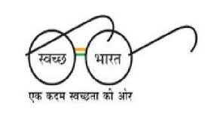
Pro-poor Initiatives-I
UJJWALA YOJANA
Launched on May 1, 2016
Target: 5 crore originally, now
8 crore by March 2020
Achievement so far: 3.57 crore connections released.
PMAY Gramin
Launched on November 20, 2016
Target: 1 crore houses by March 2019
Achievement so far: 74.93 lakh sanctioned.
38.22 lakh completed.
60 lakh completion by June 2018.
1 crore by December 2018.
SAUBHAGYA
Sahaj Bijli Har Ghar Yojana
Launched on September, 2017
Target: 3.7 crore households
Achievement so far: 39 lakh electrified
3.3 crore by Mar 2019.
SBM-Gramin
Launched on October 2, 2014
Target: ODF by October 2, 2019.
Achievement so far: 6.8 crore toilets built.
3.4 lakh villages made ODF.
365 Districts made ODF.

Slide 4



Pro-poor Initiatives-II
Pradhan Mantri Jan Dhan Yojana (PMJDY)
Launched on March 2015
Target: Universal access to Banking facilities
March 2015 – 14.71 crore accounts
March 2018 – 31.44 crore Accounts.
Achievement so far: Rs. 78,494 crore deposit mobilized.
4675 Life Insurance claims paid.
Pradhan Mantri Jeevan Jyoti
Bima Yojana (PMJJBY)
Launched on May 9, 2015
Coverage so far: 5.33 crore beneficiaries enrolled.
Achievement so far: 90082 claims of Rs. 1802 crore disbursed.
Pradhan Mantri Suraksha
Bima Yojana (PMSBY)
Launched on May 9, 2015
Coverage so far: 13.49 crore enrolled.
Achievement so far: 16,469 claims of Rs. 328 cr. disbursed.

Slide 5

Gram Swaraj Abhiyan
Ambedkar Jayanti April 14, 2018 (Sat)
PM’s address from Bijapur.
District Workshops on taking forward Dr. Ambedkar’s ideas.
Camps for Caste/Income Certificate; scholarship enrolment, Bank Account and Adhaar linkage.
Swachh Bharat Parv April 18, 2018 (Wed)
Village Cleanliness Drive -
Making ODF, ODF+++
Making non ODF, ODF.
Cleanliness drives in every village.
Solid and Liquid Resource Management.

Slide 6


Gram Swaraj Abhiyan
Ujjawala Diwas April 20, 2018 (Fri)
15000 LPG Panchayats and issue of 100 new connections per Panchayat.
Demonstration on safety.
Panchayati Raj Diwas April 24, 2018 (Tue)
National & Gram Sabha level -
PM’s Jabalpur address.
Launch of RGSA programme.
e-Launch of LGD for every village.
Gram Sabha in every GP – Public Information Campaign.

Slide 7
Gram Swaraj Abhiyan
Gram Shakti Abhiyan April 28, 2018 (Sat)
District HQ level –
- Kiosk/stall/counter – on Saubhagya.
- 100-200 connections by DISCOM.
- Sale of LED Bulbs by EESL.
- PMAY-G / Saubhagya – Sammelan
Experience sharing
Awards to – Blocks / GPs & Personnel

Slide 8

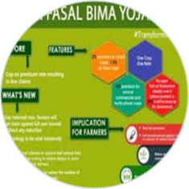
Gram Swaraj Abhiyan
Aayushman Bharat Abhiyan April 30, 2018 (Mon)
GP level validation –
Explain benefits.
Reach eligible beneficiaries.
Capture additional information of eligible beneficiaries – phone, Ration Card, family details.
Educate on process.
Kisan Kalyan Karyashala May 2, 2018 (Wed)
Block level –
- Workshop on doubling farmers’ income.

Slide 9




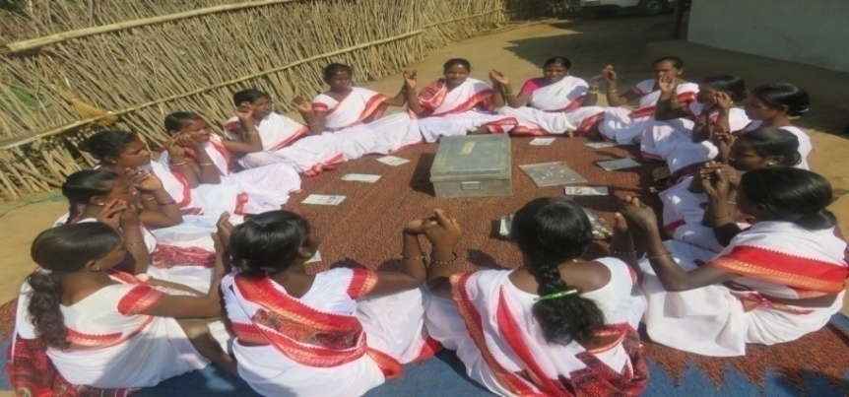
Gram Swaraj Abhiyan
Aajeevika & Kaushal Vikas Mela May 5, 2018 (Sat)
National and 4000 Block level
- Celebrating Success Stories – Role Models – One lakh women and youth.

Slide 10
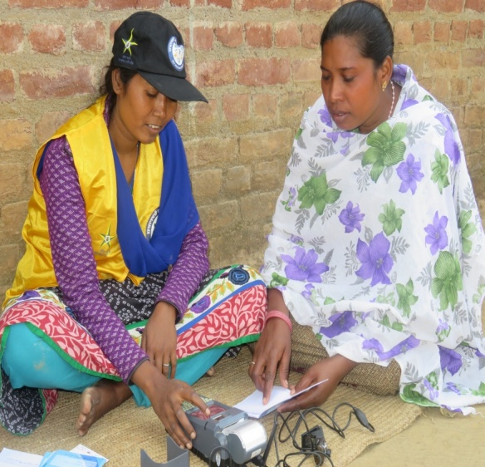
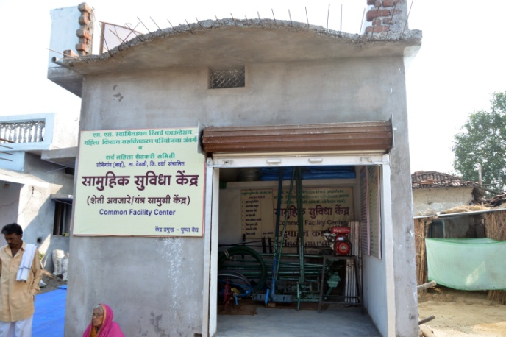
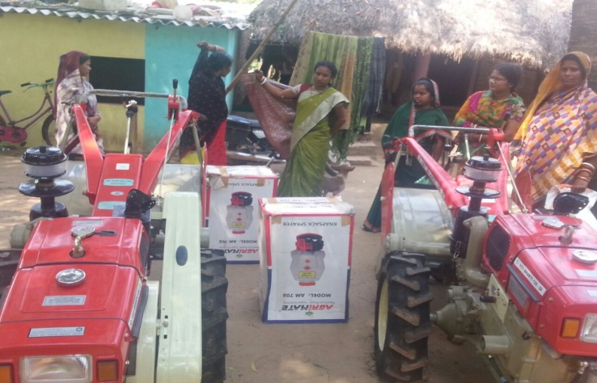
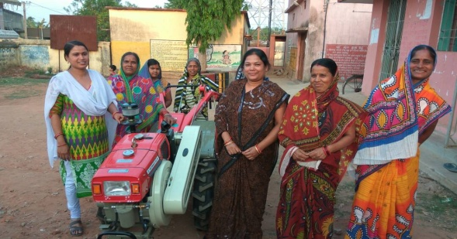
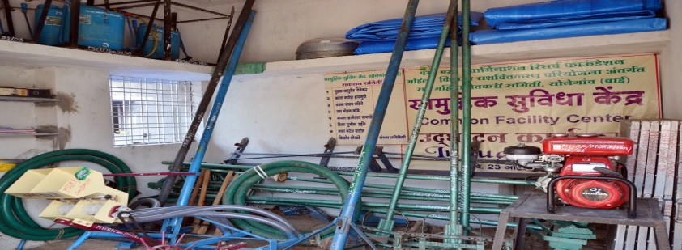
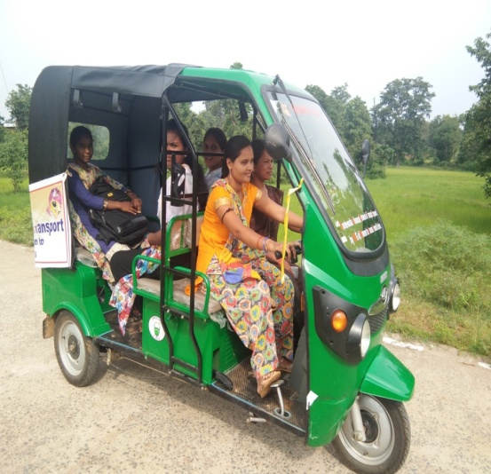
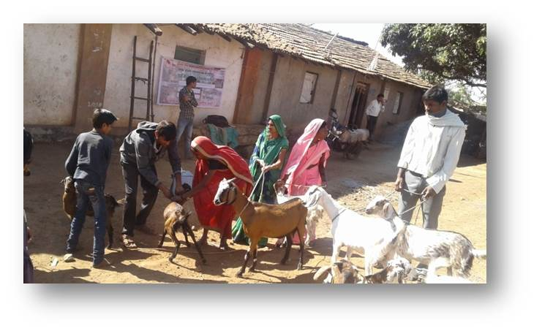
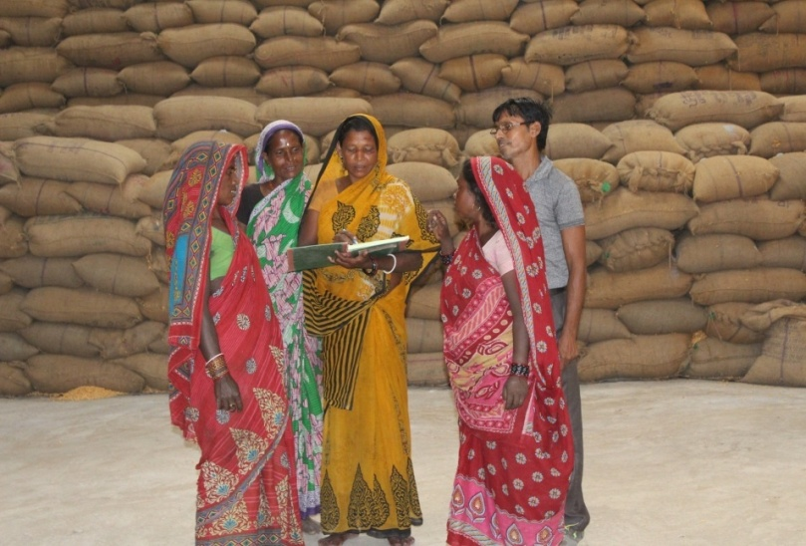
Celebrating Success Stories

Slide 11
Organisation of Gram Swaraj Abhiyan
A partnership of beneficiaries, 33 lakh elected PRIs members, 5 crore women SHG members, MLAs and MPs to achieve goals.
Central/State and Local Governments as partners in progress.
Real time effective monitoring of campaign through Apps and common portal.

Slide 12
Coordination & Monitoring
M/o Panchayati Raj & D/o Rural Development to coordinate.
Specific Responsibilities discussed and finalized.
Letter sent to State Chief Secretaries. Video Conference on 5.4.2018.
Monitoring Dashboard for daily update.

Slide 13
Special Initiatives in 21,058 villages in 530 Districts
[Saturate 16850 villages in 484 Districts excluding Karnataka and West Bengal]
Saturate 21058 villages during the Abhiyan under
Pradhan Mantri Ujjawala Yojana
Saubhagya (Pradhan Mantri Sahaj Bijli Har Ghar Yojana)
Ujala Scheme
Pradhan Mantri Jan Dhan Yojana
Pradhan Mantri Jeevan Jyoti Bima Yojana
Pradhan Mantri Suraksha Bima Yojana
Mission Indradhanush

Slide 14
100% Saturation coverage
Between 14th April to 5th May.
Plan of Action by each participating Ministry.
Dashboard/Portal for Daily monitoring.
Intensive focused Mission for Saturation - Local, State, Central Government.
Out of 530 Districts, 94 are Aspirational Districts.

Slide 15
Actions Taken
Letters to Chief Secretaries.
VC by Cabinet Secretary with all Chief Secretaries & DMs.
List of selected villages sent.
Line Departments have prepared their Action Plans.
Media Plan prepared.

Slide 16
Monitoring Framework
Two Class-I officers deployed for each District to visit and coordinate.
State Nodal Officers appointed by all Ministries
States requested to make a nodal officer for each Block.
Prabhari Officer to also oversee in Aspirational Districts.
Web Portal for real-time monitoring of progress under all programmes to be captured on this common Portal.
Daily Monitoring of Special Interventions.

Slide 17
Visit of Ministers/MPs
Briefing Pack for every Hon’ble Minister/MP on Performance of Programmes in 2017-18 and priorities in 2018-19.
Visit of elected representatives MPs, MLAs, Zila Parishad and Block Adhyakshas, other PRI representatives for participation in various proposed programmes.

